Slide 1
Digital Portfolio
STUDENT NAME: KATHIRAVAN.K
REGISTER NO AND NMID: 24132251802521023
DEPARTMENT: B.Sc COMPUTER SCIENCE
COLLEGE:GOVERNMENT ARTS AND SCIENCE COLLEGEvanur ANNAMALAI / UNIVERSITY

Slide 2
PROJECT TITLE
* STUDENT DIGITAL PORTFOLIO
* GIVE A CLEAR, CONCISE,AND MEANINGFUL TITLE FOR YOUR PROJECT

Slide 3


AGENDA
Problem Statement
Project Overview
End Users
Tools and Technologies
Portfolio design and Layout
Features and Functionality
Results and Screenshots
Conclusion
Github Link
3/21/2024 Annual Review

Slide 4

PROBLEM STATEMENT
* STUDENTS ARE STRUGGLE TO SHOW CASE THEIR SKILLS, ACHIEVEMENT AND LEARNING SKILLS
* TRADITIONAL RESUMES AND REPORT CARD ARE FULLY EXPRESS STUDENTS CREATIVITY, GROWTH,AND SKILLS

Slide 5

PROJECT OVERVIEW
* PROVIDE A SHORT DESCRIPTION OF YOUR PROJECT IDEA
* MENTION THE PURPOSE, SCOPE, AND MAIN OBJECTIVE

Slide 6

WHO ARE THE END USERS?
GENERAL PURPOSE:
* Show case our work, growth,and achievements all in one place
* Easily upload,organize and share what matter most to you
STUDENT:
*This is more than just grades ,it is the students voice , vision, evolution

Slide 7

TOOLS AND TECHNIQUES
* Programming language: python,Java,c++ etc
*FRAMEWORK: Django,react flutter,etc
*Database : MySQL,mongoda,etc
* TOOLS: GitHub ,FIGMA ,vs code , Arduino,etc

Slide 8
POTFOLIO DESIGN AND LAYOUT
* Structure of the portfolio (section, navigation)
* Color theme ,front style,visual elements
* Use diagram, flowcharts,and images for better presentetion
8

Slide 9
FEATURES AND FUNCTIONALITY
*List The main Features Of Your Project
*Smart Sensors Detect Waste Level
*Automatic Notification System
*Dashboard For Monitoring
* Mobile App Integration

Slide 10
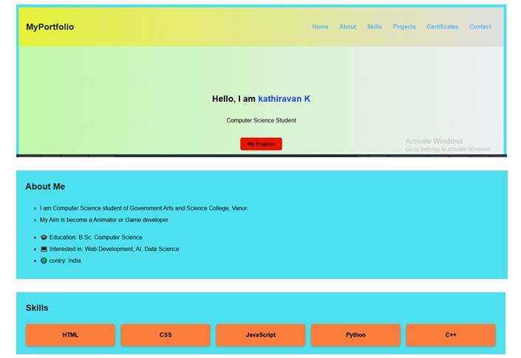

RESULTS AND SCREENSHOTS
3/21/2024 Annual Review
10

Slide 11
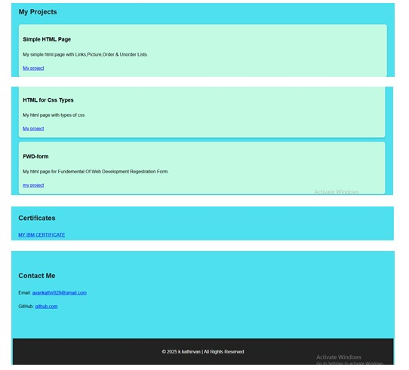
RESULT AND SCREENSHOT

Slide 12
CONCLUSION
* creating a student digital portfolio was more than just putting together few web pages.
* It was and hands on journy thougth the tools techniques that shape modern communication.
*. By using HTML,CSS, and JavaScript, I built a space that reflects my skills, achievements and personilty.
*. These tools not just help me a belt website,they helped me build confidence creativity, and a deeper understanding of digital expression
12

Slide 13
GITHUB LINK
For more context Me on GITHUB
https://github.com/kathir200643/Portfolio-.git

